Slide 1
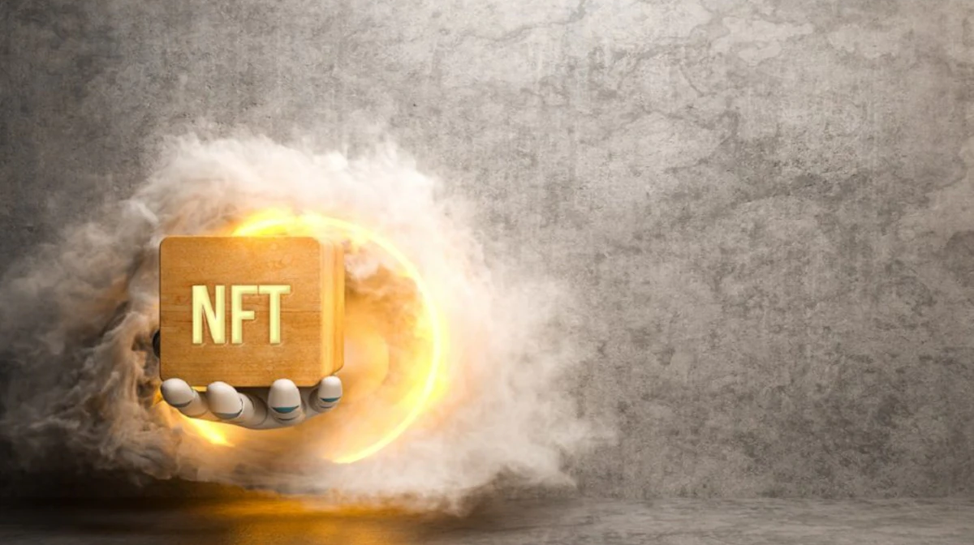
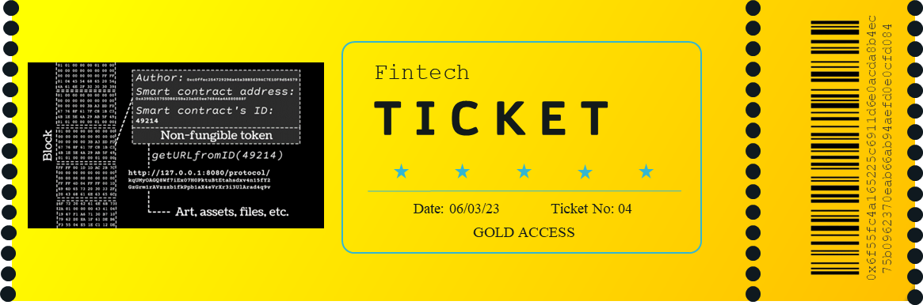
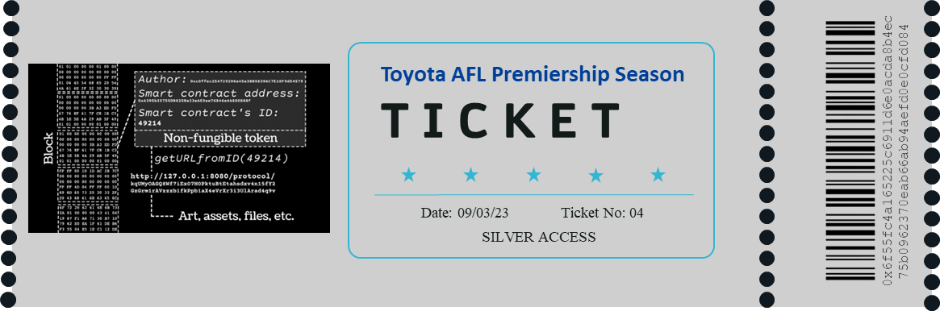
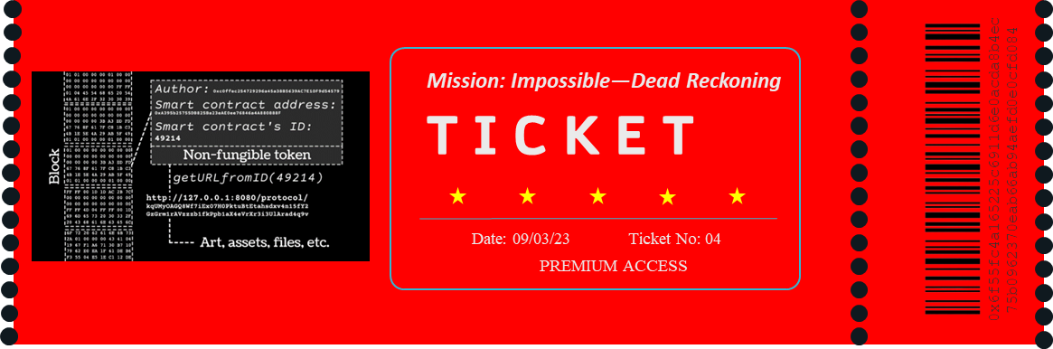
NFTix
Project group 4
Anti-scalping blockchain based event Ticketing system
ix
Guy Adam
Venkata Nagothi
Sreeni Patnaik

Slide 2
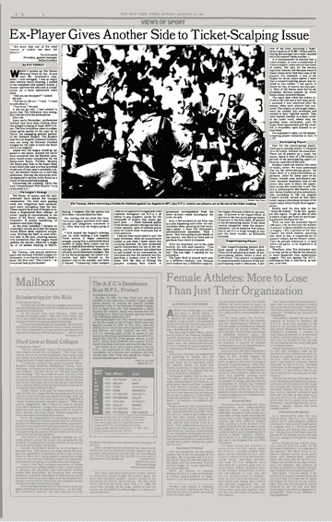
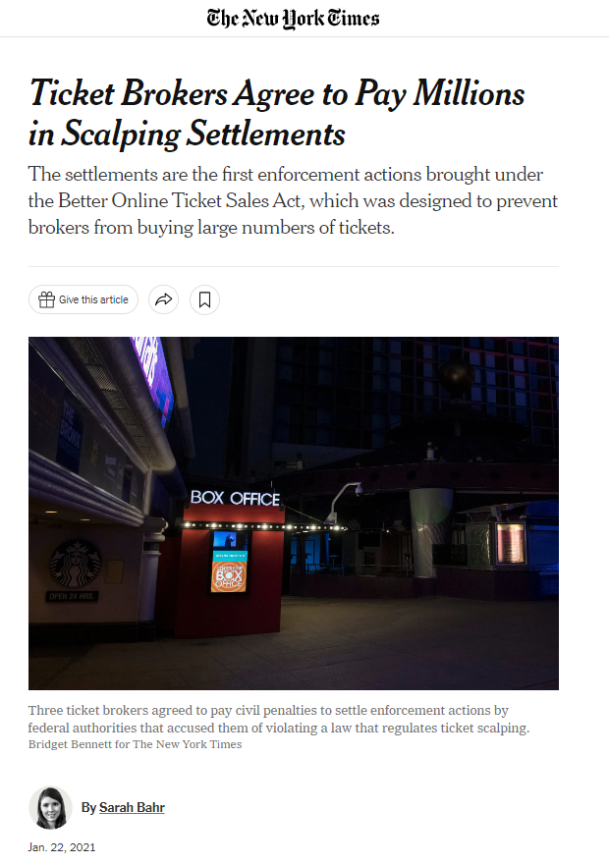
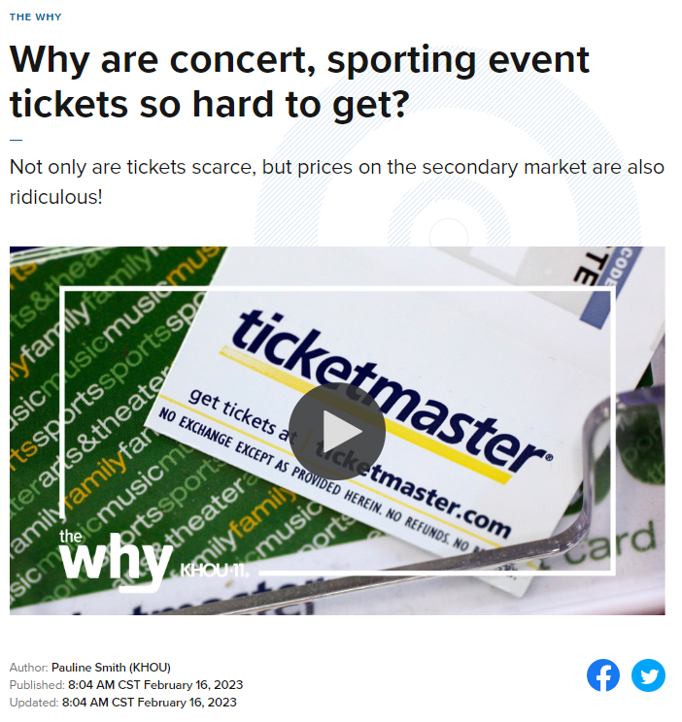
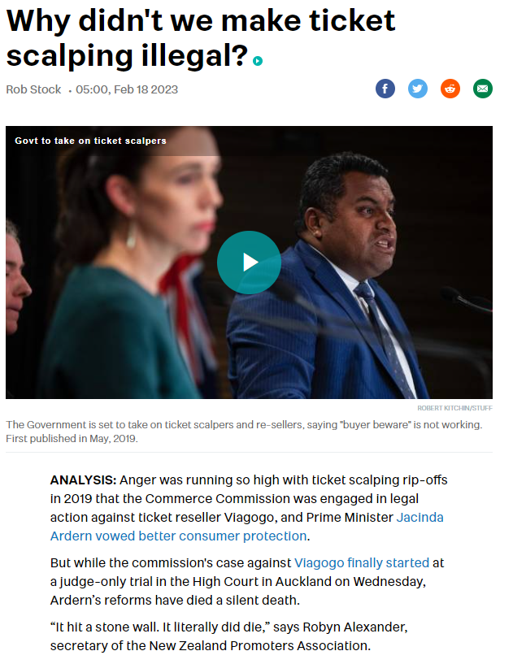
Ticket scalping is a significant issue
Ticket scalping can lead to higher ticket prices, reduced accessibility, fraud and counterfeiting, and negative impacts on the event industry. For example, in 2019, it was reported that a scalper had made around $18 million in profits from selling tickets to the Broadway show "Hamilton."

Slide 3
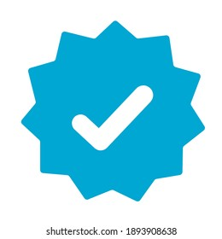



Authenticity
Non Fungible Token
(NFT) Ticketing
NFT ticketing ensures that tickets are unique and cannot be duplicated or counterfeited. This helps prevent ticket fraud and ensures that the tickets sold are legitimate.
Transparency
NFT ticketing are a transparent way to track the entire lifecycle of a ticket. This includes information such as when the ticket was created, who bought it, and how many times it was transferred.
Event tickets using blockchain technology
The objective of this project is to build a resilient Non-Fungible Event ticketing application that has one-of-a-kind tokens stored on blockchain and can be transferred from the issuer to the buyer’s wallet. The organizers of the event can mint as many tickets as they need.

Accessibility
NFT ticketing can make it easier for fans to access and purchase tickets. Since the tickets are stored digitally, they can be easily distributed and sold across the globe.

Revenue Sharing
NFT ticketing enables event organizers to implement revenue-sharing models that can benefit both artists or performers. Blockchain can distribute royalties to the relevant parties based on predetermined rules.

Slide 4
Application Workflow
1 | Event Organizer | Event organizer inputs event details in Streamlit application Once saved, event details are pushed to the PostgreSQL database in the backend Flexible to edit event details in-case of any changes to the events.
2 | Event Participant | Event participants login to view registered events and schedules Check available tickets and cost to purchase tickets Choose the event, number of tickets and select a wallet to purchase ticket
3 | Solidity | Once submitted to purchase the transaction is executed though the algorithm written on Solidity. Solidity Registers ticket Purchase on Ethereum Blockchain and generates a unique hash value as a receipt to uniquely identify the purchase A successful transaction will make a database call to store the event_id, transaction_id and Buyer's contract Address in a table called "nftix.events_sales" table.

Slide 5
Technical Architecture
We read 100s of business editorials and interview Fortune 100 executives to discover the best resources to help improve your career.
01
02
03
04
Postgre SQL
Python
Streamlit
Solidity
Database to store details of all events and receive calls from Streamlit/Python to store ticket purchases. We used "psycopg2" Python module in Python for query execution on PostgreSQL database
Python application interacts with PostgreSQL database and the Streamlit to cater to the requests made by Streamlit to store and retreive the data to and from PostgreSQL database
Streamlit application as a frontend accepts user inputs for Events addition and buy event tickets.
Streamlit interacts with Python and Solidity for each transaction
Actual ticket purchasing activity on the blockchain is performed and run in Solidity. Ganache is used as a buyer's wallet solely for test application purpose.

Slide 6
Technical Architecture
We read 100s of business editorials and interview Fortune 100 executives to discover the best resources to help improve your career.
01
02
03
04
05
Postgre SQL
Streamlit
Solidity
To be updated
To be updated
Database to store details of all events and receive calls from Streamlit/Python to store ticket purchases. We used "psycopg2" Python module in Python for query execution on PostgreSQL database
Streamlit application as a frontend accepts user inputs for Events addition and buy event tickets.
Streamlit interacts with Python and Solidity for each transaction
Actual ticket purchasing activity on the blockchain is performed and run in Solidity. Ganache is used as a buyer's wallet solely for test application purpose.
Ask Guy and Venkat on 4th and 5th component
Ask Guy and Venkat on 4th and 5th component

Slide 7

Dataflow
psycopg2
Streamlit
Events Table
Events_Sales
Python

Slide 8
Our Approach
Include Relevant Code
Include any relevant code or demonstrations of the analysis or application.
Techniques
How did we Test and evaluate the code
Unanticipated Insights
Problems that arose and how were they resolved

Slide 9
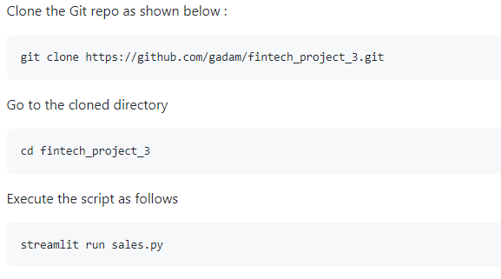
Dependencies and Script Execution Process
Dependencies
To ensure the code executes well, below are the pre-requisites and dependecies to be full-filled :
A PostgreSQL database must be installed and must be running on port 5432
Login to the PostgreSQL database and run the following script so that the database is created with the required schema, tables and the data
psql -p 5432 postgres -U postgres\i FintechProj3_DB_build.sql
Ensure "Streamlit" is successfully installed
Ensure "psycopg2" module is successfully installed
Ensure Web3==5.17.0 is successfully installed
Script Execution

Slide 10
Results and conclusions from the analysis
Include relevant images or examples to support your work
If the project goal wasn’t achieved, share the issues and what the group tried for resolving them

Slide 11
Next Steps
Take a moment to discuss the potential next steps for the project.
Discuss any additional questions that you’d explore if you had more time. Specifically, if you had additional weeks to work on your project, what would you research next?
Change fronted from Streamlit to Javascript, react based fronted. Allows to refresh the menu and the options
Environment has to be more robust, a proper build environment to allow us to debug and retrieve the data that has been encrypted
Choose a different deployment architecture e.g. having proper wallets
Build Mobile applications both frontend and backend
Ethereum is a distributied system that is better than a centralized bu

Slide 12
Appendix

Slide 13
ix

Slide 14
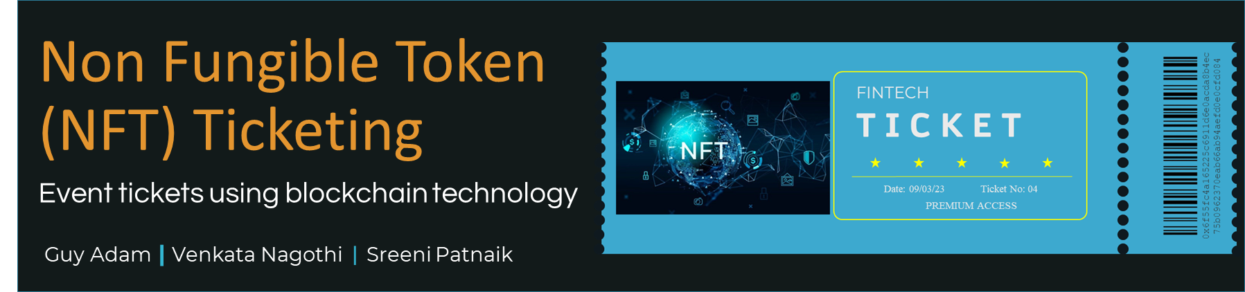
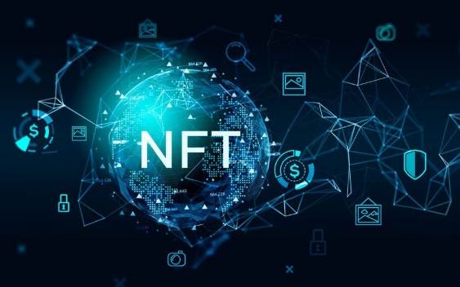
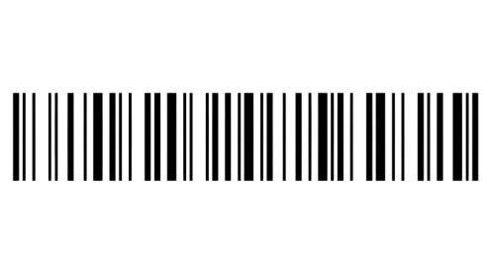
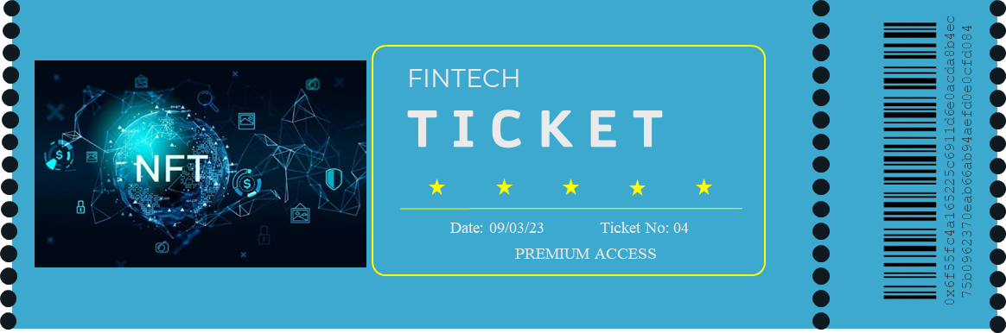
FINTECH
T I C K E T
0x6f55fc4a165225c6911d6e0acda8b4ec
75b0962370eab66ab94aefd0e0cfd084
Date: 09/03/23
Ticket No: 04
PREMIUM ACCESS
Non Fungible Token
(NFT) Ticketing
Event tickets using blockchain technology
Guy Adam | Venkata Nagothi | Sreeni Patnaik

Slide 15






Introduction
What is
NFT Ticketing?
NFT Tickets are one-of-a-kind tokens stored on a specific blockchain, which can be transferred from the issuer to the buyer’s wallet. The organizers of the event can mint as many tickets as they need, including using batch minting protocols.

